Slide 1
CS5542 Big Data Analytics and Applications Tutorial 1 - Installations
January 18th 2018
UMKC

Slide 2
Topics to cover
Installations
Ubuntu
Git and ZenHub
IntelliJ
Pycharm
SBT and Maven
Spark
Android Installation
Tensorflow
Lab Submission Guidelines

Slide 3
Introduction of Ubuntu
Debian-based Linux operating system
Open source
Latest release: 15.10
Latest preview: 16.04
Install Ubuntu 14.04 LTS

Slide 4
Ubuntu Installation
Install Oracle VM Virtual Box:
https://www.virtualbox.org/wiki/Downloads
On windows:
http://www.htpcbeginner.com/install-virtualbox-on-windows/
On Mac os x:
http://aztcs.org/meeting_notes/mac/virtualmachines/virtualbox/VirtualBoxMac.pdf
Install Ubuntu 14.04 LTS using Oracle VM Virtual Box:
https://brb.nci.nih.gov/bdge/installUbuntu.html
Notes:
Install Java in Ubuntu if it's not available.
If you want to make use of GPU, it's not possible with Virtual machine OS. You may have to install Ubuntu directly in a seperate hard drive partition. Check if your GPU is compatible with Tensorflow.
People with Mac OS can run tensorflow directly, you don't need to install Ubuntu. All the installation procedures are going to be different (Intellij, pycharm, git, tensorflow etc.). But if you want to install Ubuntu you can follow the same procedure using Virtual Machine.

Slide 5
Git Basic Tasks
1. Create Git remote repository using Git account
2. Clone Git repository to your local
3. Use Git to add file into local
4. Modify files and use Git to commit change
5. Use Git to push the commit to remote
6. Use Git to pull (sync) content with remote

Slide 6
Git Project Management Tasks
1. Use Git to branch a project
2. Use Git to check different branches
3. Use Git to merge different versions

Slide 7
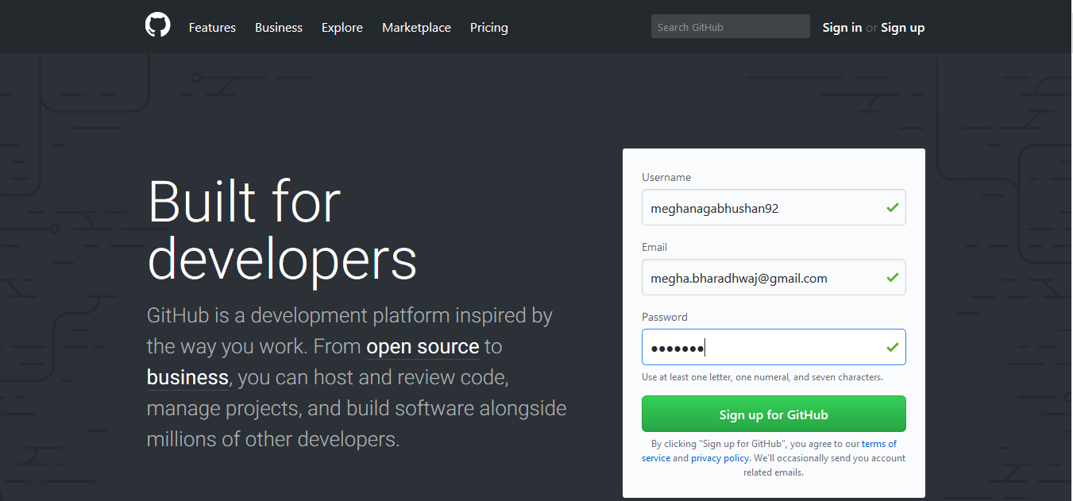
Git 1. Create Git Account

Slide 8
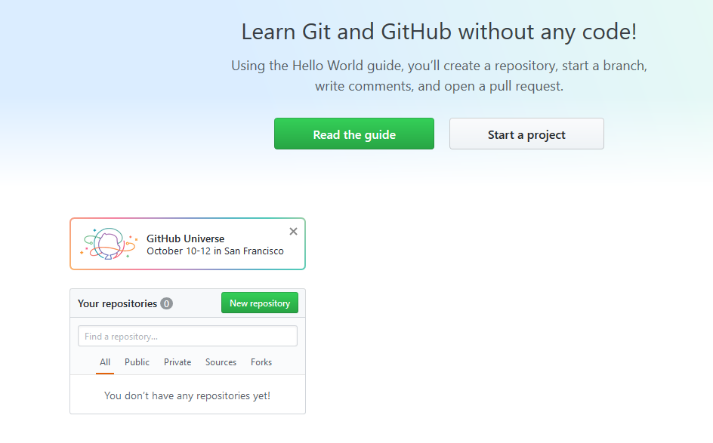
Git 2. Create Repository

Slide 9
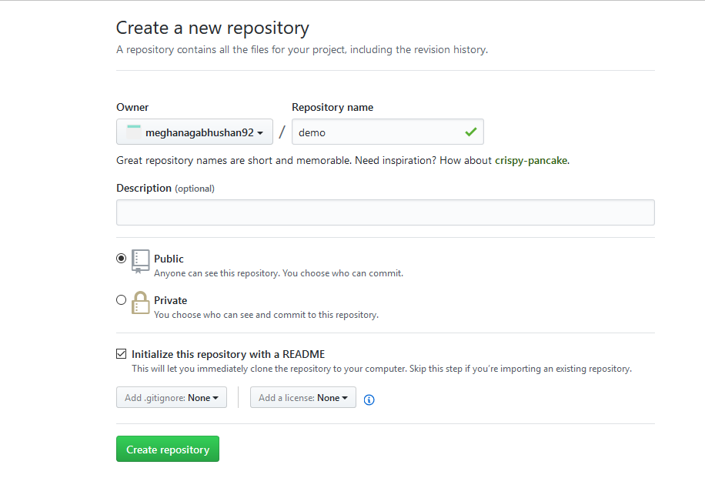
Git 2. Create Repository
create a sample repository.

Slide 10
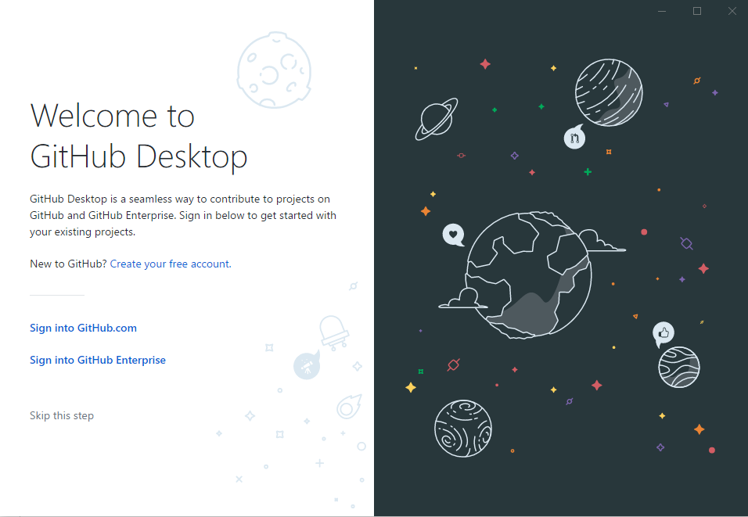
Git Desktop
Download git using this link - https://git-scm.com/downloads
Download Github Desktop using this link - https://desktop.github.com/

Slide 11

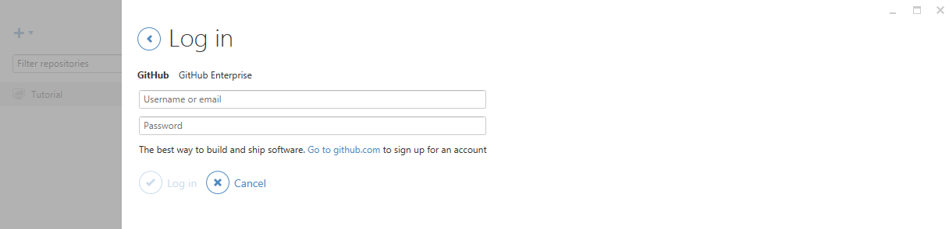
Git
For Windows user, please open GitHub desktop by double clicking icon
login to your GitHub desktop with your GitHub account (It is very important to login before you do the rest of steps. Because after you login, you secure connection has been made)

Slide 12
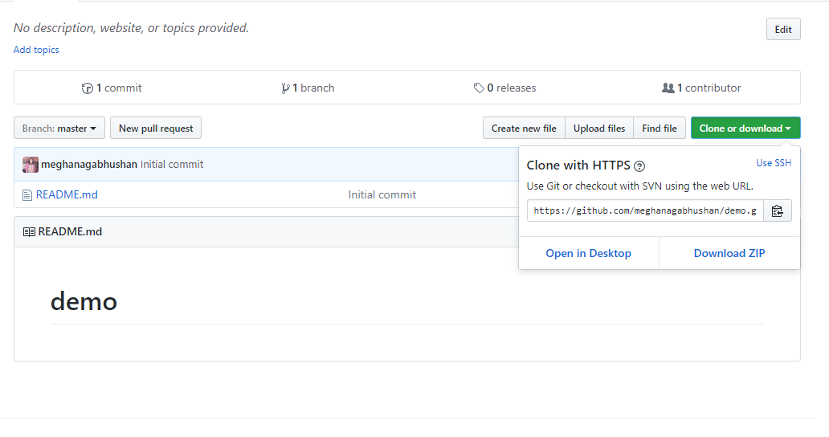
Git 3. Clone repository to your local
Click on "Clone or Download" -> "Open in Desktop".

Slide 13
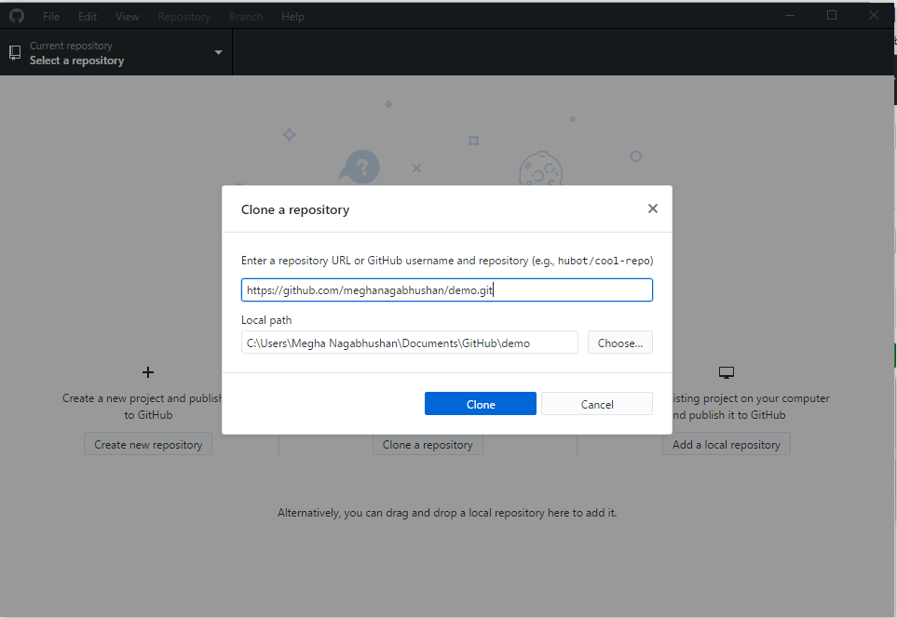
Git 3. Clone repository to your local
Choose the path to save your repository.

Slide 14
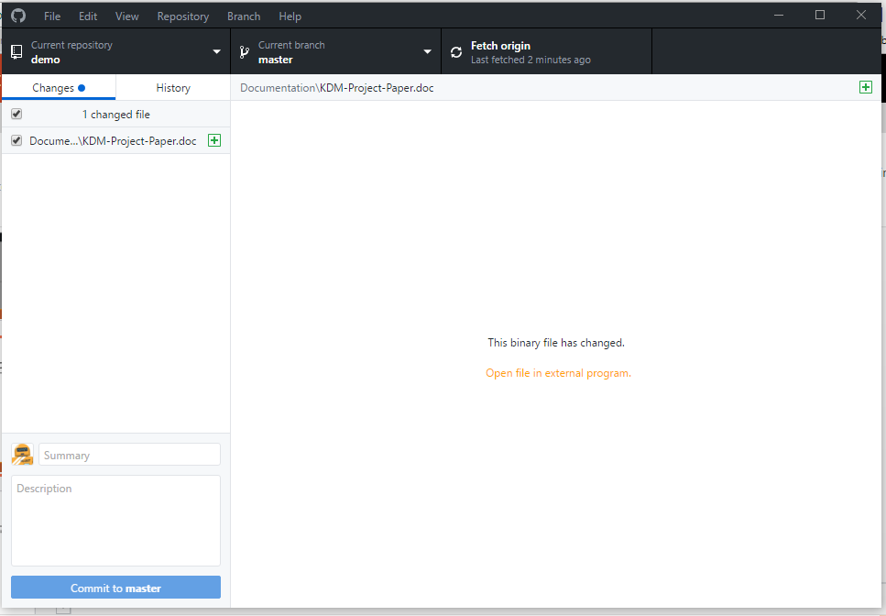
Git 4. Add file to local Repository
Go to the location of your repository.
Create a Source and Documentation folder.
Add a sample file in the Documentation folder.

Slide 15
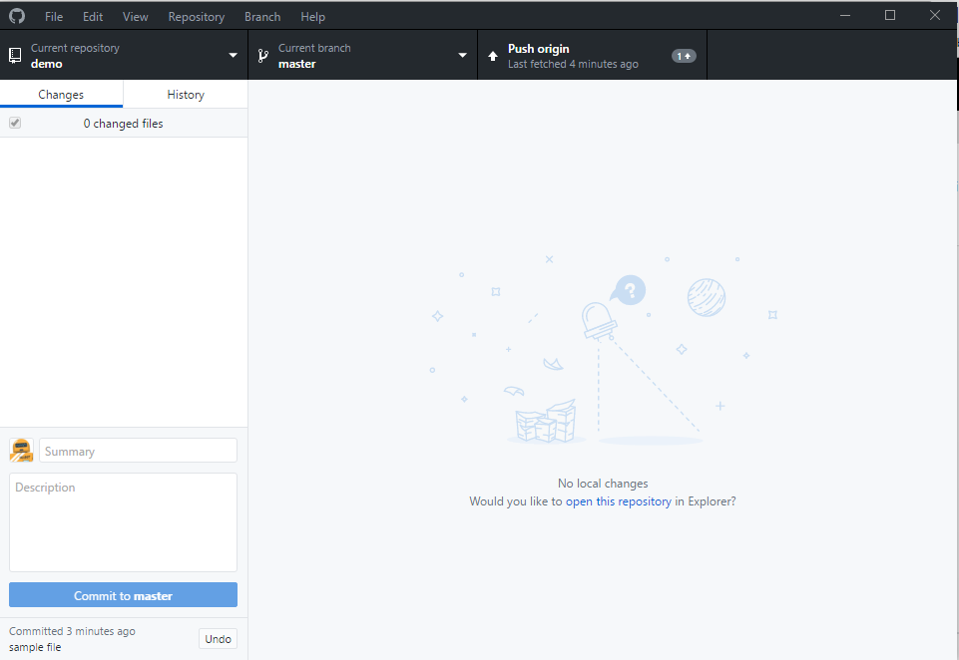
Git 5. Commit this change
Fill summary and description boxes and click on Commit to master.

Slide 16
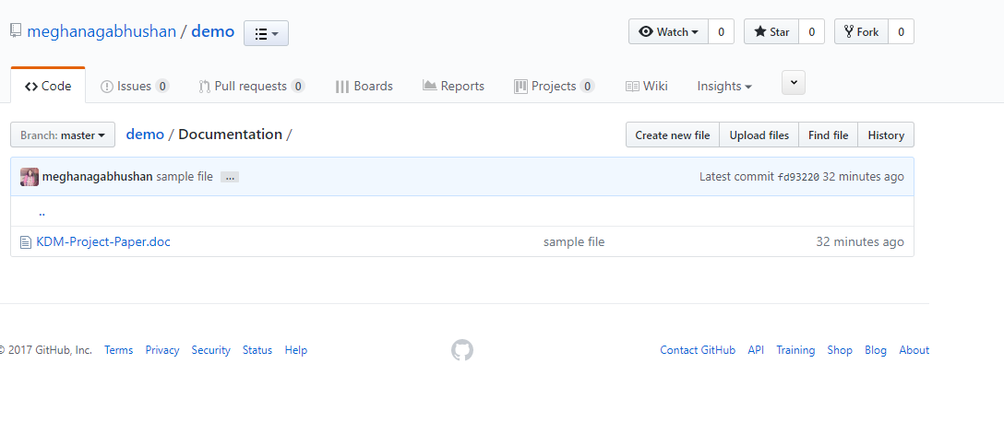
Git 6. Push the change to remote
Click on "Push origin" at the top of the git desktop screen.
Open the repository on your Github. The file will now be visible in your repository.

Slide 17
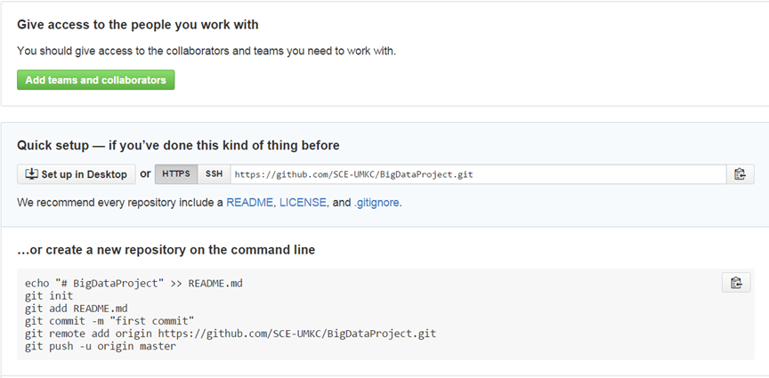
Git bash 3. Clone repository to your local
Copy the repository link git clone https://github.com/xxxxxxx.git

Slide 18
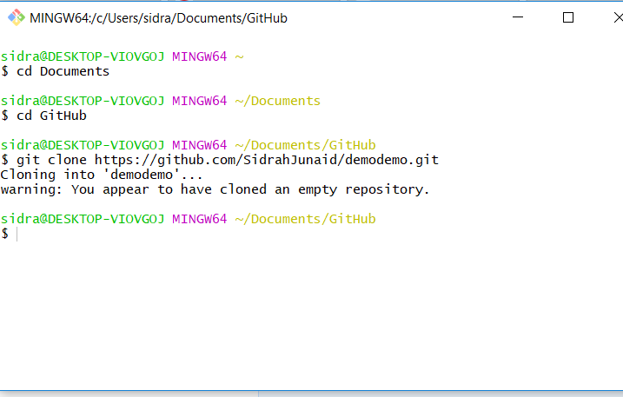
Git bash 3. Clone repository to your local
Open git bash and clone repository in your desired folder

Slide 19
After clone, you will find a folder has the same name as repository
Use the following command to go inside the folder
cd <folder_name> (e.g., cd BigDataProject)

Slide 20
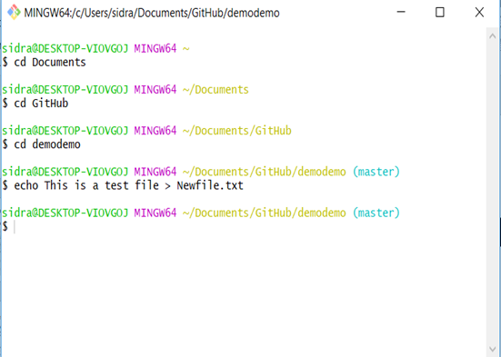
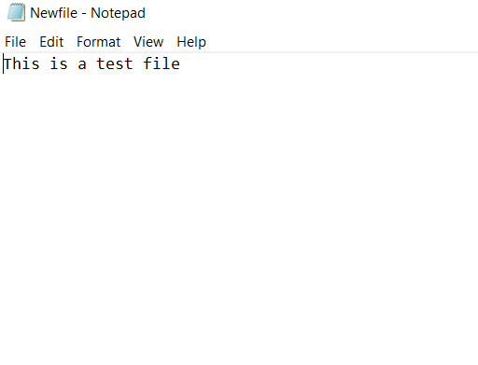
Git bash 4. Add file to local repository
For creating a text file window users

Slide 21
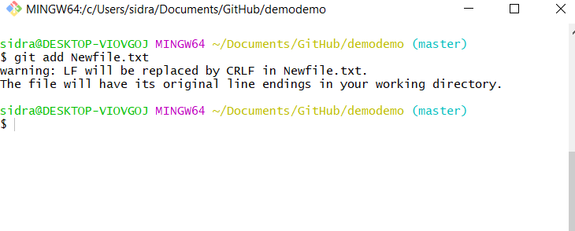
Git bash 4. Add a file from local

Slide 22
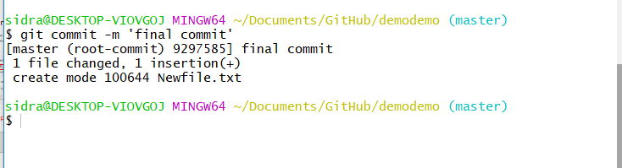
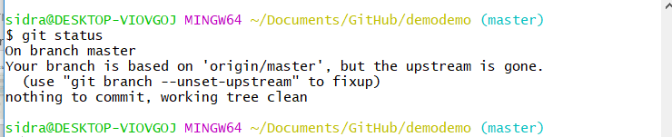
Git bash 5. Commit this change
After commit, you can check git status to see if work directory clean

Slide 23
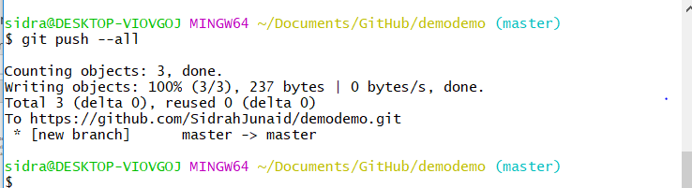
Git bash 6. Push the change to remote
Push all changes to remote Github

Slide 24
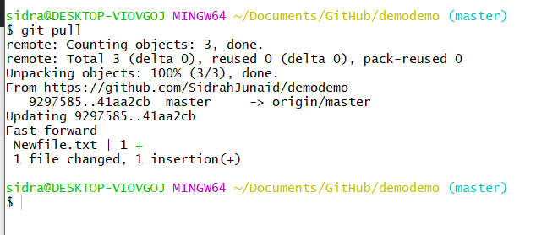
Git bash 7. Sync local with remote
If something change in remote, for sync purpose, you can type

Slide 25
Git Project Management 1. Branch
Create a branch
Delete a branch
Force delete a branch
Rename current branch

Slide 26
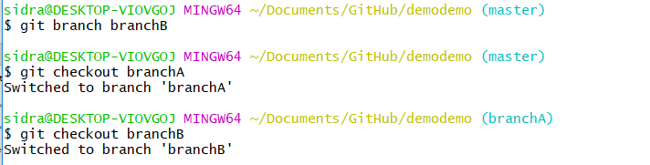
Git Project Management 2. Checkout
A and B has to checkout their own branch to work on

Slide 27
Git Project Management 3. Merge
•User A works on featureA, after finish, user A commit it with the message ‘finish featureA’
•git commit –m ‘finish featureA’
•User B works on featureB, after finish, user B commit it with the message ‘finish featureB’
•git commit –m ‘finish featureB’
•User C works on main features on master branch, user C commit it with the message ‘finish main features’
•git commit –m ‘finish main features’

Slide 28
For now, Windows users have done all basic steps.
But for Linux and Mac users, there are some more steps

Slide 29
(Non-Windows User)
• For Linux or Mac user, we have more work to do before pushing change to remote
Here are the steps
1. Generating new SSH Key and adding SSH Key to the ssh-agent
2.Adding a new SSH key to your GitHub account

Slide 30
1. Generating new SSH Key and adding SSH Key to the ssh-agent
•1. Generate a SSH key with your GitHub email address
ssh-keygen -t rsa -b 4096 -C “your_email@example.com”
•2. It will ask you the file name
Enter a file in which to save the key (/Users/you/.ssh/id_rsa): [Press enter]
•3. Save this key and passphrase. Give the key name and make passphrase as empty.
Enter passphrase (empty for no passphrase): [Type a passphrase]
Enter same passphrase again: [Type passphrase again]
•For example:
we give key name as id_rsa, key pair would be: id_rsa and id_rsa.pub

Slide 31
Contd…
4. Adding SSH key to the ssh-agent
eval "$(ssh-agent -s)”
5. If you're using macOS Sierra 10.12.2 or later, you will need to modify your ~/.ssh/config file to automatically load keys into the ssh-agent and store passphrases in your keychain.
Host * s
AddKeysToAgent yes
UseKeychain yes
IdentityFile ~/.ssh/id_rsa
6. Adding ssh key to ssh-agent
ssh-add -K ~/.ssh/id_rsa

Slide 32
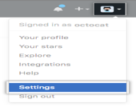
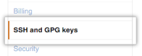
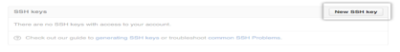
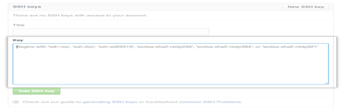
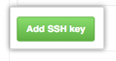
2. Adding SSH key to Github account
1. Copy key to your GitHub account
In the user bar in the top-right corner of page,
click setting button
2. Click SSH Keys in the left sidebar
3. Click Add SSH key
4.In the Title field, add a descriptive label for key
Paste your key into the "Key" field
5. Click Add key.

Slide 33
Testing
6. SSH to GitHub for testing ssh -T git@github.com
7. Switching remote URLs from HTTPs to SSH
git remote set-url origin git@gxxxxxx.gits

Slide 34
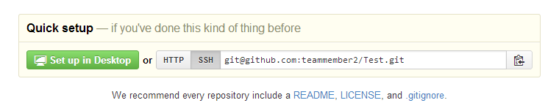
Contd…
8. Now you can push using
git push –all
9. If something change in remote, for sync purpose, you can type
git pull

Slide 35

ZenHub for GitHub project management
ZenHub is a GitHub plugin for agile project management
It needs either Chrome or Firefox as the browser.
Go to https://www.zenhub.io/
Click “Add ZenHub to GitHub”, it will install a plugin on your browser
Click plugin icon
It will ask you to login to GitHub (You have to create your GitHub account before)
After login, you have to grant the permission for ZenHub to access your GitHub project
Done

Slide 36
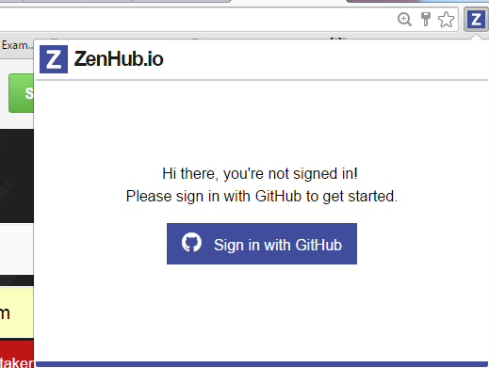

Slide 37
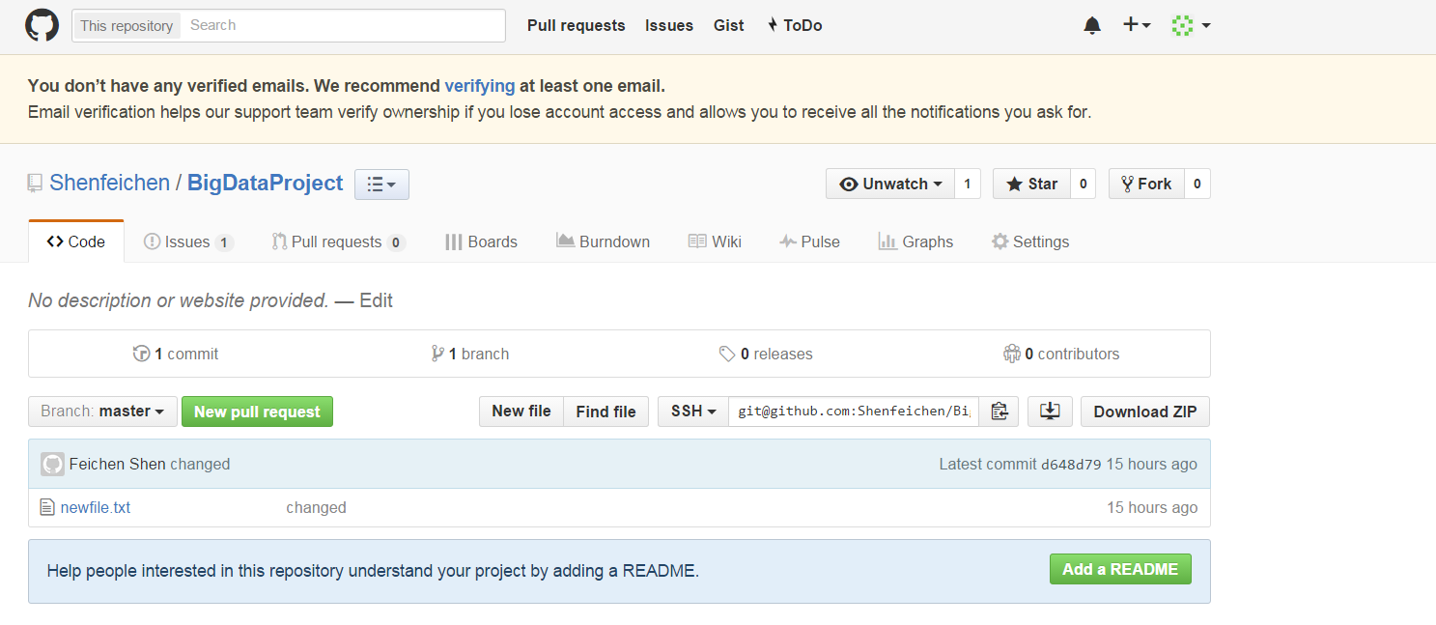
ZenHub
Click issues, we can add issues
Click Boards, we can drag and drop stories to different completion status
Click burndown, we can add milestone and assign different stories to milestone and then generate burndown chart

Slide 38
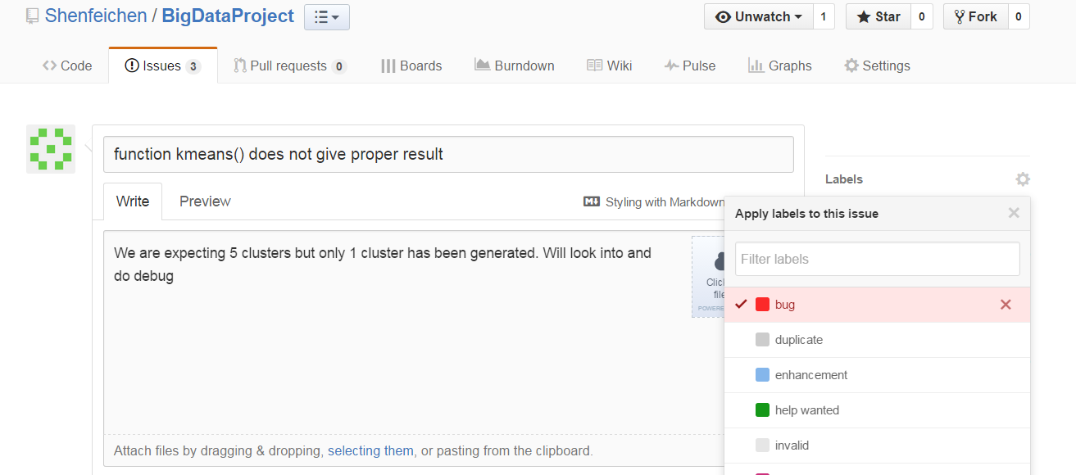
Add Issues
Click issues
Click New issues

Slide 39
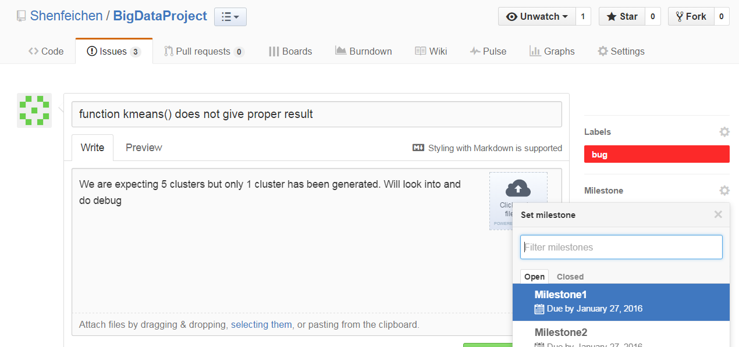
Add Issues

Slide 40
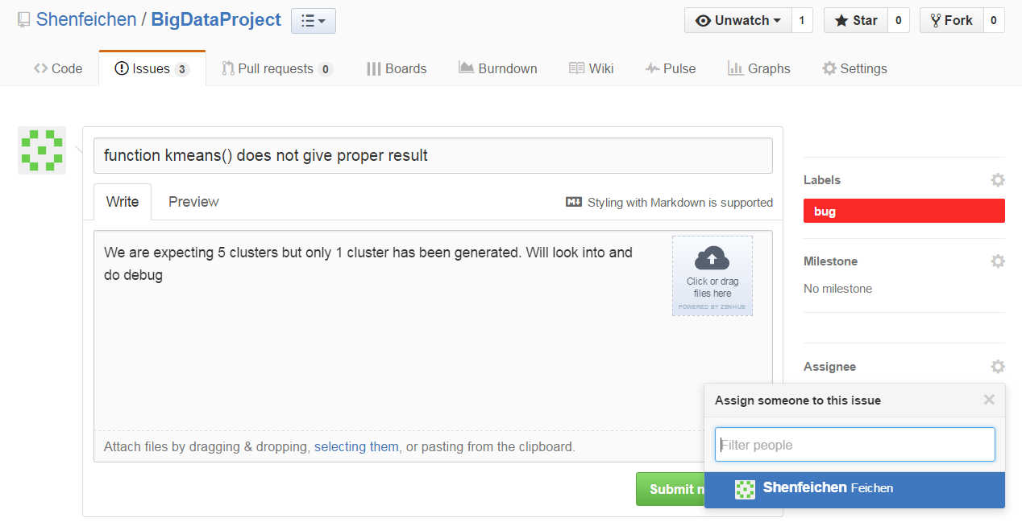
Add Issues

Slide 41
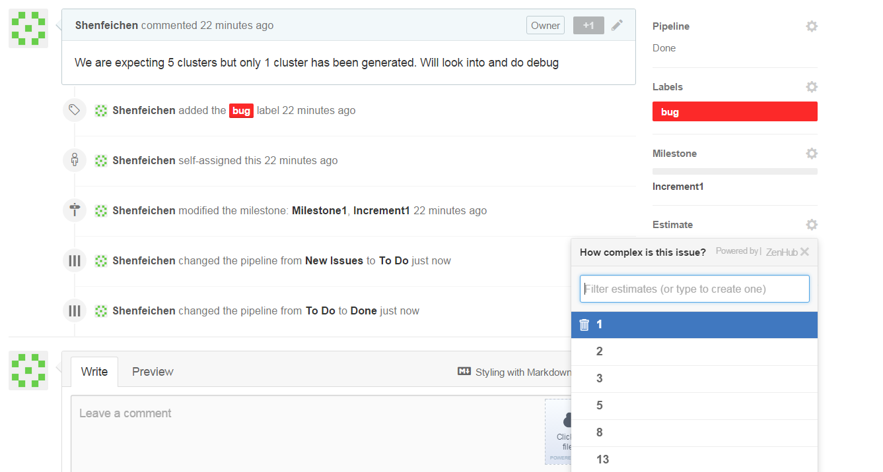
Add Issues
Story point is a arbitrary measure used by Scrum teams. This is used to measure the effort required to implement a story.

Slide 42
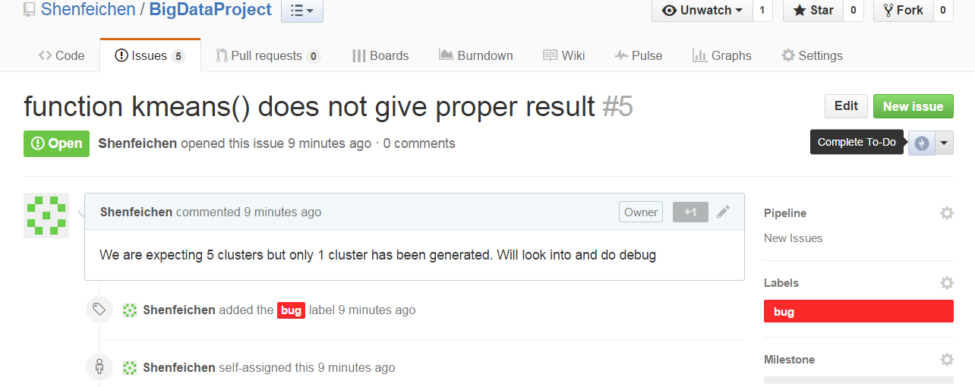
Add Issues

Slide 43
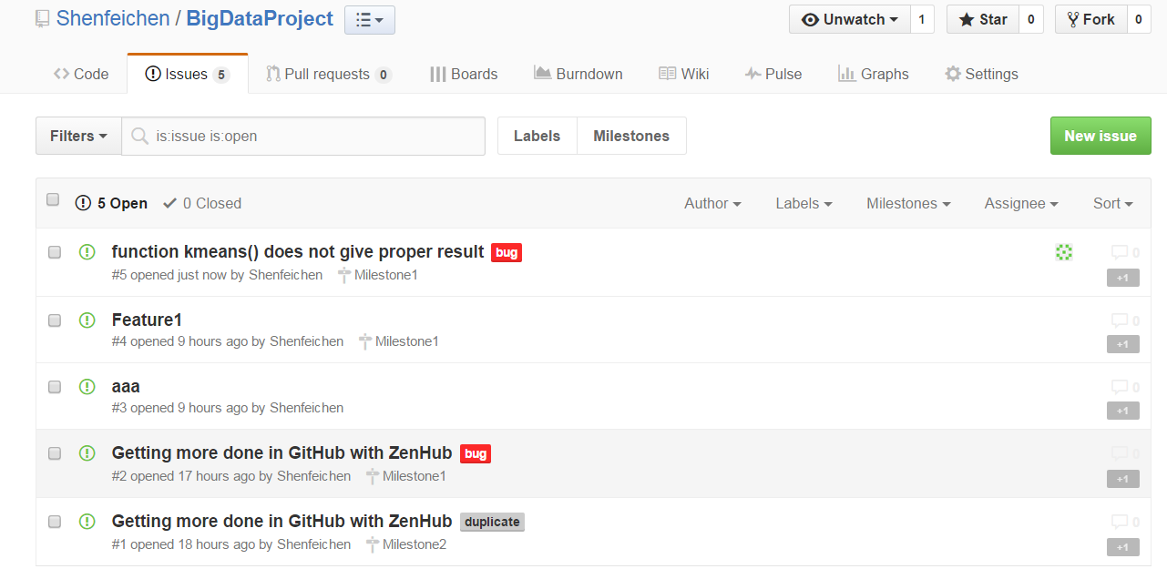
Add Issues

Slide 44
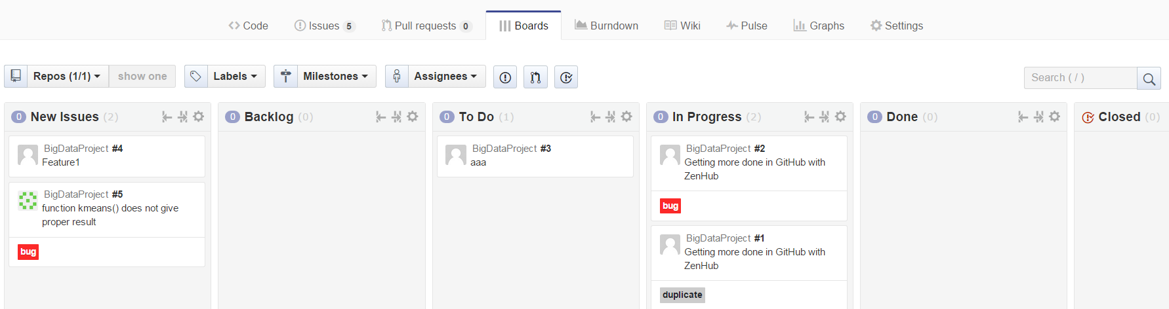
Board

Slide 45
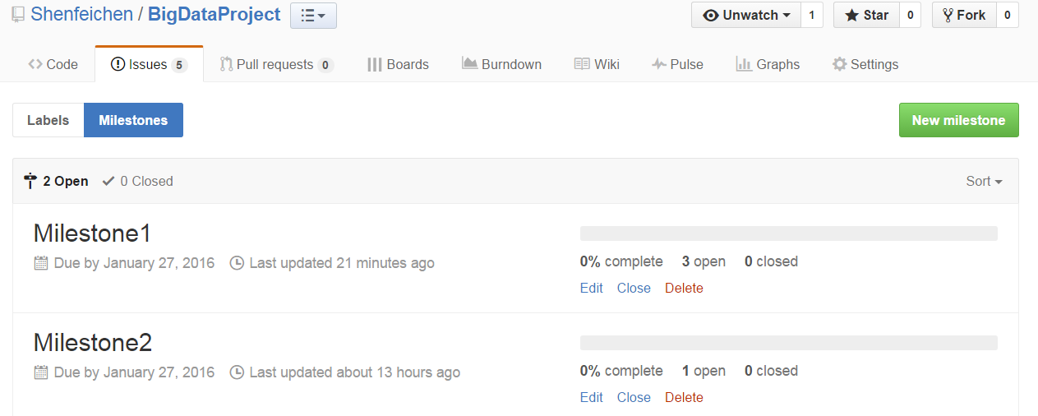
Add Milestones
Issues → Milestones → New Milestones
You can create Milestones

Slide 46
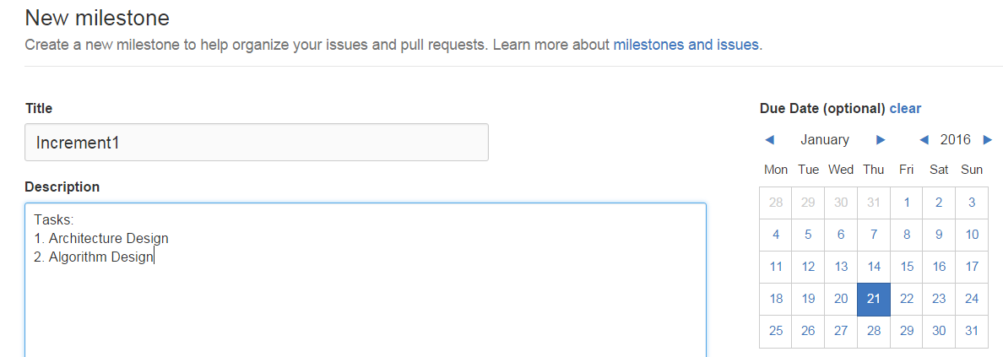
Add Milestones

Slide 47
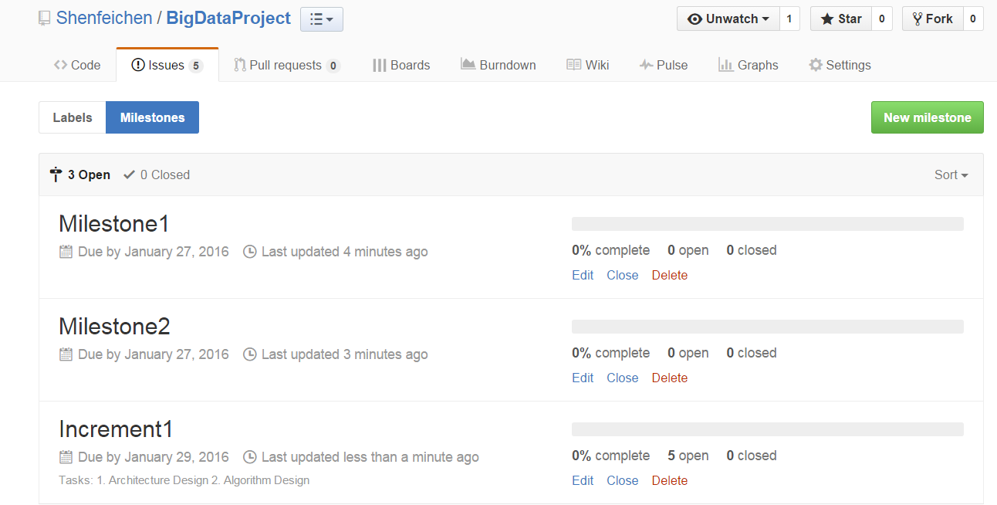

Slide 48
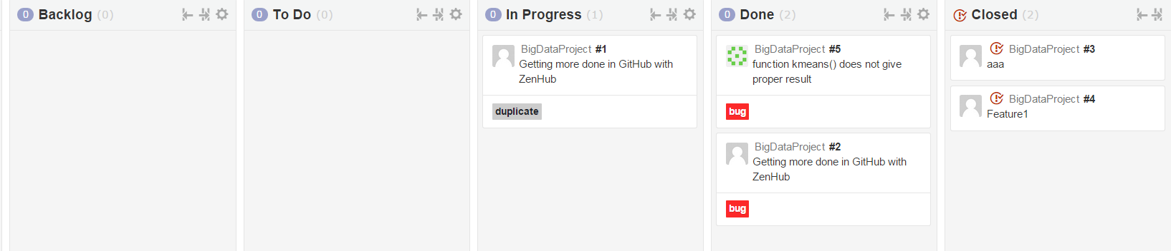
Add Milestones
Increment1 has 5 issues
I drag two of them to “Closed” status

Slide 49
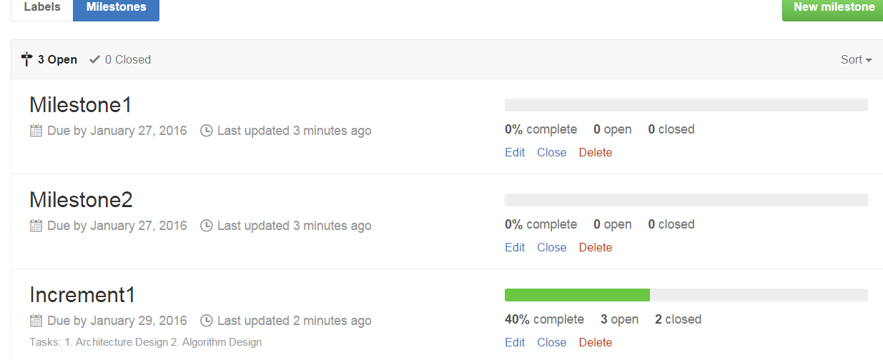
Add Milestones
Then the complete of Milestones will also change

Slide 50
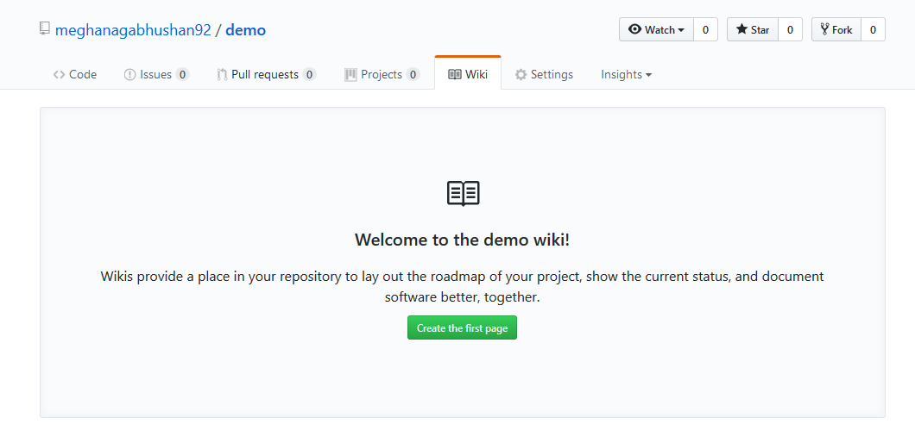
Wiki
Every GitHub repository comes equipped with a section for hosting documentation, called a wiki.

Slide 51
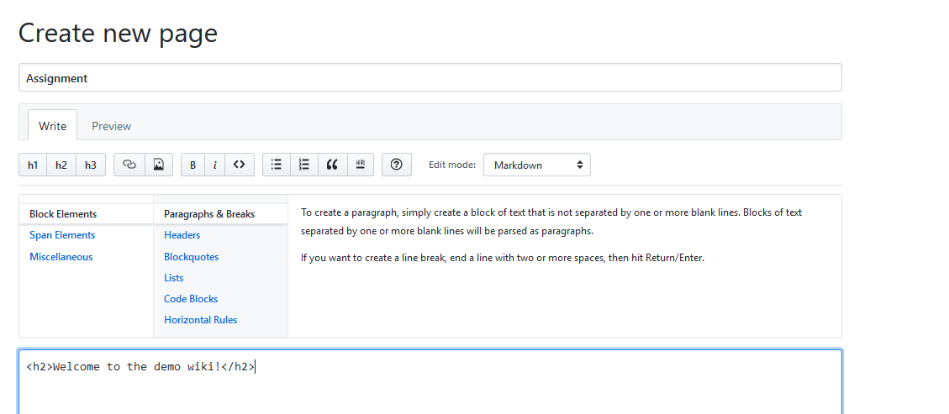
Wiki

Slide 52
Build Burndown Chart
A burn down chart is a graphical representation of work left to do versus time.

Slide 53
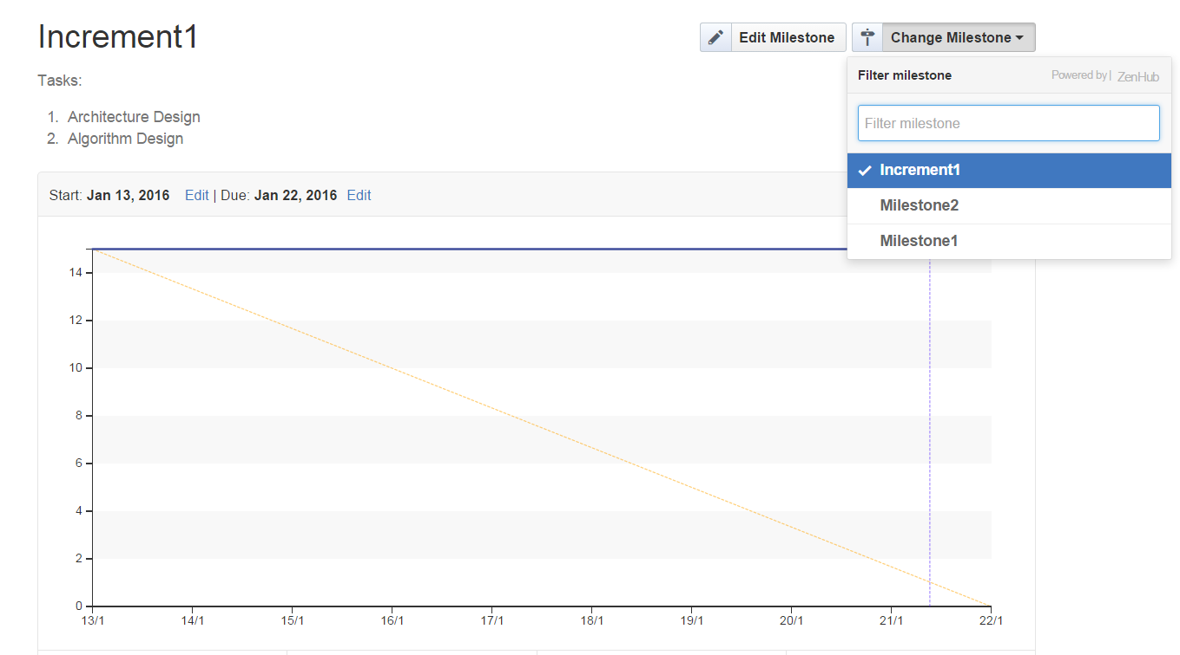
Build Burndown Chart
Go to burndown option, select a specific milestone, to see the burndown chart

Slide 54
Code Contribution
The Code Contribution on the Github Project will be used to evaluate your individual score on the contribution towards the project.

Slide 55
INTELLIJ

Slide 56
IntelliJ
Java- Scala integrated development environment (IDE)
Can be Downloaded from https://www.jetbrains.com/idea/
IDE used for Storm and Spark

Slide 57
Intellij Ubuntu
https://www.jetbrains.com/idea/download/#section=linux
Move to desired installation location
Unpack the idea idea-2016.3.3.tar.gz file using the following command: tar xfz idea-2016.3.3.tar.gz
Run idea.sh from the bin subdirectory
To run idea.sh: command: sh idea.sh

Slide 58
Attention
Make sure to add Scala to IntelliJ environment while installing

Slide 59
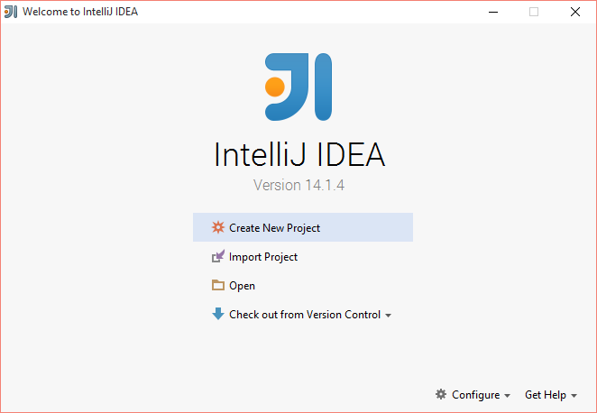

Slide 60
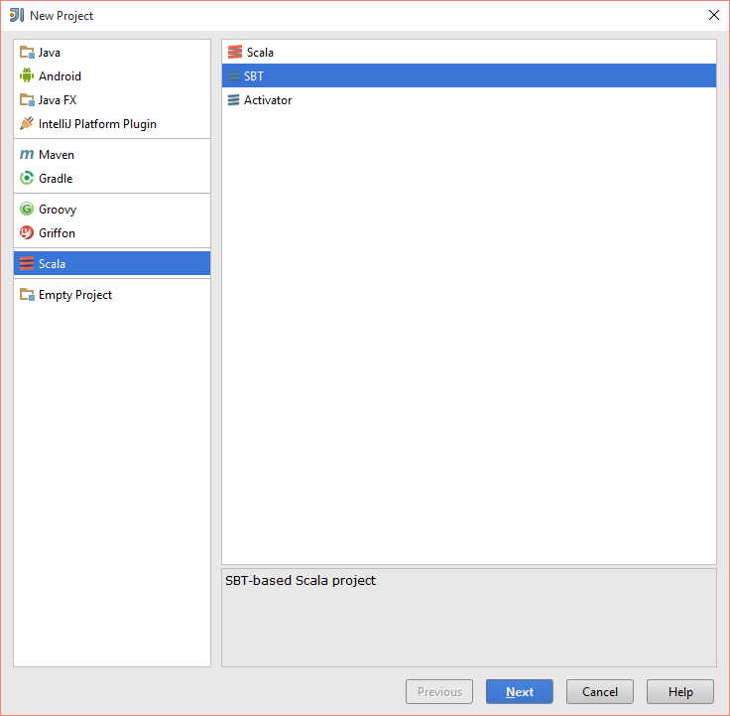
For Scala Project

Slide 61
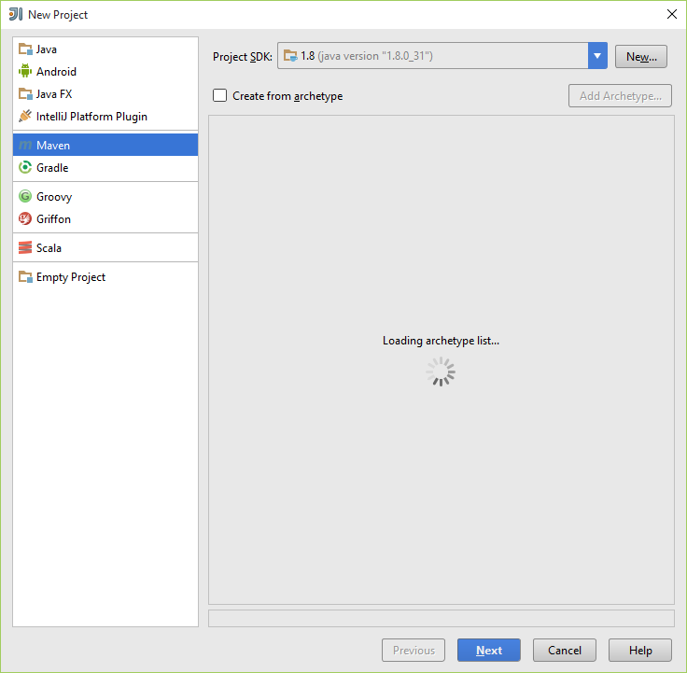
For Java Project

Slide 62
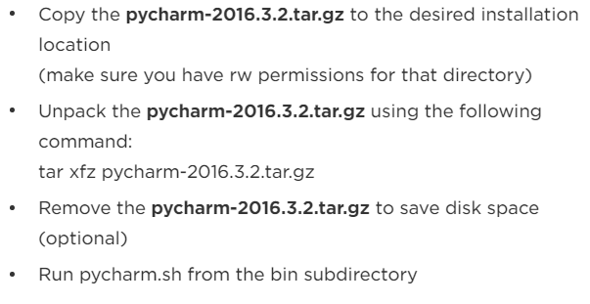
PyCharm
https://www.jetbrains.com/pycharm/download/#section=linux

Slide 63
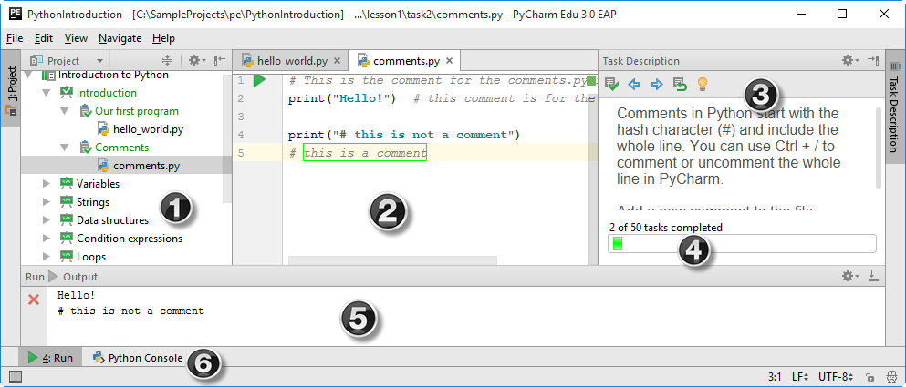
PyCharm
Notes:
Where (1) is the Project tool window that shows the project itself, (2) is the editor, (3) is the Task Description tool window with the course progress bar (4) , (5) is the Run tool window and (6) is the Python Console tool button.

Slide 64
BUILD TOOLS: SBT and MAVEN

Slide 65
What is Build Tools?
Build automation is the act of scripting or automating a wide variety of tasks that software developers do in their day-to-day activities including things like:
compiling computer source code into binary code
packaging binary code
running automated tests
deploying to production systems
creating documentation and/or release notes

Slide 66
SBT
SBT stands for Scala Build Tool
SBT is an open source build tool for Scala and Java projects, similar to Java's Maven or Ant.

Slide 67
SBT - Installation
http://www.scala-sbt.org/0.13/tutorial/Installing-sbt-on-Windows.html
Install SBT.

Slide 68
SBT Commands
sbt clean : cleans the jars and classes generated from previous run
sbt package : creates a light jar, with the classes generated
sbt assembly : creates a fat jar without all the dependies compiled with it.
Note : we would be creating fat jar for deployment in spark

Slide 69
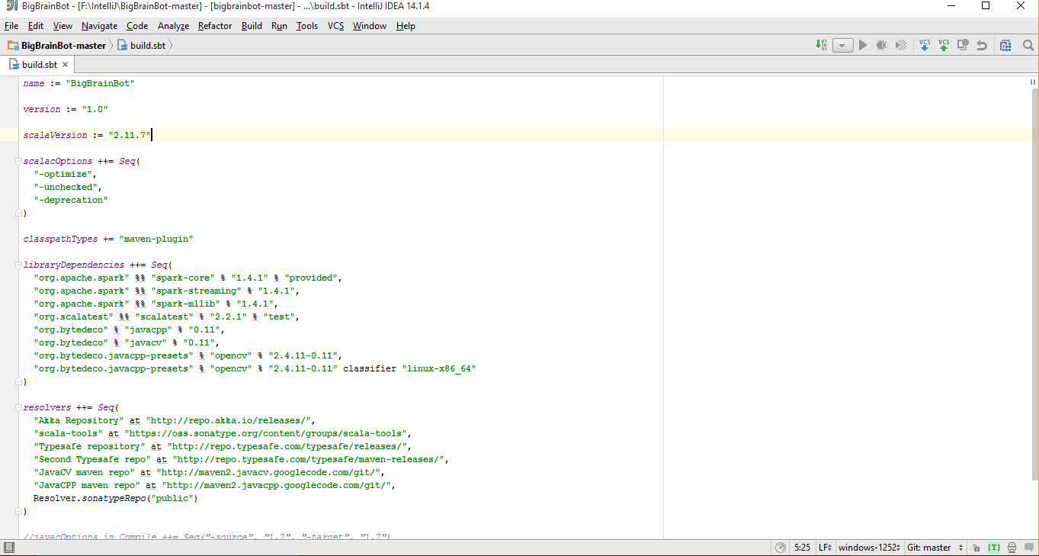
SBT related Files
Two main files which are involved with sbt are
Build.sbt : Dependencies libraries are specified

Slide 70
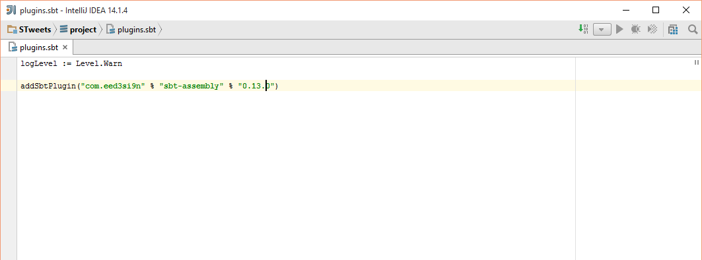
SBT related Files
Plugins.sbt / assembly.sbt : The version of sbt used is specified in this

Slide 71
Maven
Apache Maven is a software project management and comprehension tool. Based on the concept of a project object model (POM), Maven can manage a project's build, reporting and documentation from a central piece of information.

Slide 72
Maven - Installation
https://maven.apache.org/
Install Maven

Slide 73
Maven Commands
mvn compile - compile the source code of the project
mvn test - test the compiled source code using a suitable unit testing framework. These tests should not require the code be packaged or deployed
mvn package - take the compiled code and package it in its distributable format, such as a JAR.

Slide 74

Maven related File: pom.xml

Slide 75

Install Apache Spark Locally
http://spark.apache.org/downloads.html

Slide 76


Slide 77

spark-1.5.0.tgz will be downloaded
Use Winrar or some tool to extract the archived file on to the destination folder.
Latest is 2.2.1

Slide 78
Building Spark
Now go to the root folder of spark using terminal/Command Prompt
Go to Git Bash.
To the spark folder and run the following command.
bulid/sbt clean assembly.
It takes a while to bulid spark

Slide 79
Starting Spark
Use the terminal to run spark-shell.
Go to spark1.5.0/bin folder.
Run the following command
spark-shell : spark-shell command opens a scala terminal
You can use this terminal, to type scala commands to execute

Slide 80
Android Studio Installation

Slide 81
Getting Started (1)
Install Java Development Kit (JDK) to write Java (and Android )programs
Do not install Java Runtime Environment (JRE); JDK and JRE are different!
Can download the JDK for your OS at http://www.oracle.com/technetwork/java/javase/downloads/jdk8-downloads-2133151.html

Slide 82

Getting Started (1)
Run setup
Set Environment variable for java
Check that java is installed correctly on your machine

Slide 83
Getting Started (1)
Alternatively, for OS X, Linux:
OS X:
Open /Applications/Utilities/Terminal.app
Type javac at command line, install Java at prompt
Linux:
Debian/Ubuntu: sudo apt-­‐get install java-­‐package, download the JDK <jdk>.tar.gz file from Oracle, run make-­‐jpkg
<jdk>.tar.gz, then sudo dpkg –i <resulting-­‐deb-­‐file>
Fedora/OpenSuSE: download the JDK .rpm file from Oracle, install

Slide 84

.

Slide 85
Getting Started (2)
After installing JDK, download Android SDK from http://developer.android.com
Simplest: download and install Android Studio bundle (including Android SDK) for your OS
Alternatives:
Download/install Android Developer Tools from this site (based on Eclipse)
Install Android SDK tools by themselves, then install ADT for Eclipse separately (from this site)
We’ll use Android Studio with SDK included (easy)

Slide 86




http://developer.android.com/sdk/index.html
Install!

Slide 87
Android Virtual Device Creation

Slide 88

Open Android Studio
Click on the configure button

Slide 89
AVD Manager
Open Android studio->Click Tools -> Android -> SDK Manager->AVD Manager
Click on Create Virtual Device.
Select a device that you intend to emulate and click Next.
Select the OS that you want the device to run on.
You need to download and install OS versions in case they are not there.
Finally name your AVD and configure it. Click Finish.

Slide 90

AVD Manager

Slide 91

AVD Manager

Slide 92

AVD Manager

Slide 93

AVD Manager

Slide 94

Installation
Available in:
And python 2 and 3.
For this class we will use python3 and Ubuntu.

Slide 95

Types of Installation
CPU only and GPU enabled
Choices:
For this class prefer using virtualenv or anaconda

Slide 96

Installation(python3 for class)
Pip Installation
Make python3 default: alias python=python3
Notes:
# Ubuntu/Linux 64-bit, CPU only, Python 2.7
$ export TF_BINARY_URL=https://storage.googleapis.com/tensorflow/linux/cpu/tensorflow-1.0.0-cp27-none-linux_x86_64.whl
# Ubuntu/Linux 64-bit, GPU enabled, Python 2.7
# Requires CUDA toolkit 8.0 and CuDNN v5. For other versions, see "Installing from sources" below.
https://storage.googleapis.com/tensorflow/linux/gpu/tensorflow_gpu-1.0.0-cp27-none-linux_x86_64.whl
# Mac OS X, CPU only, Python 2.7:
$ export TF_BINARY_URL=https://storage.googleapis.com/tensorflow/mac/cpu/tensorflow-1.0.0-py2-none-any.whl
# Mac OS X, GPU enabled, Python 2.7:
$ export TF_BINARY_URL=https://storage.googleapis.com/tensorflow/mac/gpu/tensorflow_gpu-1.0.0-py2-none-any.whl
# Ubuntu/Linux 64-bit, CPU only, Python 3.4
$ export TF_BINARY_URL=https://storage.googleapis.com/tensorflow/linux/cpu/tensorflow-1.0.0-cp34-cp34m-linux_x86_64.whl
# Ubuntu/Linux 64-bit, GPU enabled, Python 3.4
# Requires CUDA toolkit 8.0 and CuDNN v5. For other versions, see "Installing from sources" below.
$ export TF_BINARY_URL=https://storage.googleapis.com/tensorflow/linux/gpu/tensorflow_gpu-1.0.0-cp34-cp34m-linux_x86_64.whl
# Ubuntu/Linux 64-bit, CPU only, Python 3.5
$ export TF_BINARY_URL=https://storage.googleapis.com/tensorflow/linux/cpu/tensorflow-1.0.0-cp35-cp35m-linux_x86_64.whl
# Ubuntu/Linux 64-bit, GPU enabled, Python 3.5
# Requires CUDA toolkit 8.0 and CuDNN v5. For other versions, see "Installing from sources" below.
$ export TF_BINARY_URL=https://storage.googleapis.com/tensorflow/linux/gpu/tensorflow_gpu-1.0.0-cp35-cp35m-linux_x86_64.whl
# Mac OS X, CPU only, Python 3.4 or 3.5:
$ export TF_BINARY_URL=https://storage.googleapis.com/tensorflow/mac/cpu/tensorflow-1.0.0-py3-none-any.whl
# Mac OS X, GPU enabled, Python 3.4 or 3.5:
$ export TF_BINARY_URL=https://storage.googleapis.com/tensorflow/mac/gpu/tensorflow_gpu-1.0.0-py3-none-any.whl

Slide 97

Installation(python3 for class)
# Ubuntu/Linux 64-bit, CPU only, Python 2.7
$ export https://storage.googleapis.com/tensorflow/linux/cpu/tensorflow-1.0.0-cp27-none-linux_x86_64.whl
Notes:
# Ubuntu/Linux 64-bit, CPU only, Python 2.7
$ export TF_BINARY_URL=https://storage.googleapis.com/tensorflow/linux/cpu/tensorflow-1.0.0-cp27-none-linux_x86_64.whl
# Ubuntu/Linux 64-bit, GPU enabled, Python 2.7
# Requires CUDA toolkit 8.0 and CuDNN v5. For other versions, see "Installing from sources" below.
https://storage.googleapis.com/tensorflow/linux/gpu/tensorflow_gpu-1.0.0-cp27-none-linux_x86_64.whl
# Mac OS X, CPU only, Python 2.7:
$ export TF_BINARY_URL=https://storage.googleapis.com/tensorflow/mac/cpu/tensorflow-1.0.0-py2-none-any.whl
# Mac OS X, GPU enabled, Python 2.7:
$ export TF_BINARY_URL=https://storage.googleapis.com/tensorflow/mac/gpu/tensorflow_gpu-1.0.0-py2-none-any.whl
# Ubuntu/Linux 64-bit, CPU only, Python 3.4
$ export TF_BINARY_URL=https://storage.googleapis.com/tensorflow/linux/cpu/tensorflow-1.0.0-cp34-cp34m-linux_x86_64.whl
# Ubuntu/Linux 64-bit, GPU enabled, Python 3.4
# Requires CUDA toolkit 8.0 and CuDNN v5. For other versions, see "Installing from sources" below.
$ export TF_BINARY_URL=https://storage.googleapis.com/tensorflow/linux/gpu/tensorflow_gpu-1.0.0-cp34-cp34m-linux_x86_64.whl
# Ubuntu/Linux 64-bit, CPU only, Python 3.5
$ export TF_BINARY_URL=https://storage.googleapis.com/tensorflow/linux/cpu/tensorflow-1.0.0-cp35-cp35m-linux_x86_64.whl
# Ubuntu/Linux 64-bit, GPU enabled, Python 3.5
# Requires CUDA toolkit 8.0 and CuDNN v5. For other versions, see "Installing from sources" below.
$ export TF_BINARY_URL=https://storage.googleapis.com/tensorflow/linux/gpu/tensorflow_gpu-1.0.0-cp35-cp35m-linux_x86_64.whl
# Mac OS X, CPU only, Python 3.4 or 3.5:
$ export TF_BINARY_URL=https://storage.googleapis.com/tensorflow/mac/cpu/tensorflow-1.0.0-py3-none-any.whl
# Mac OS X, GPU enabled, Python 3.4 or 3.5:
$ export TF_BINARY_URL=https://storage.googleapis.com/tensorflow/mac/gpu/tensorflow_gpu-1.0.0-py3-none-any.whl

Slide 98


Installation(python3 for class)
Virtualenv installation

Slide 99


Installation (python 3 for class)
Next steps are same as previous

Slide 100


Installation

Slide 101
Installation(Windows)
Not preferred for class
Anaconda mechanism is best for windows
Tensorflow only works for 64 bit and python3.5.X
Install Anaconda 64 bit https://www.continuum.io/downloads
Make anaconda's python as default in system.(change system path)
downgrade python to 3.5 version: conda install python=3.5

Slide 102
Installation(Windows)
C:> conda create -n tensorflow
C:> activate tensorflow
(tensorflow)C:> # Your prompt should change
(tensorflow) C:\Users\Manikanta>pip install --ignore-installed --upgrade https://storage.googleapis.com/tensorflow/windows/cpu/tensorflow-1.0.0-cp35-cp35m-win_x86_64.whl
or
https://storage.googleapis.com/tensorflow/windows/cpu/tensorflow-1.0.0-cp35-cp35m-win_amd64.whl

Slide 103

Test Installation

Slide 104

Sample code
import tensorflow as tf
a = tf.placeholder("float") b = tf.placeholder("float")
y = tf.mul(a, b) sess = tf.Session()
print sess.run(y, feed_dict={a: 4, b: 5})

Slide 105
Wiki: Lab Submission
Create a repository for all Lab assignment submissions
Create a folder for each lab assignment and place all code inside source code folder
Use Github wiki pages to submit reports for each lab
Include all wiki links in README.md file

Slide 106

Wiki: Lab Submission

Slide 107

Wiki: Lab Submission

Slide 108

Wiki: Lab Submission

Slide 109
END

